Slide 1
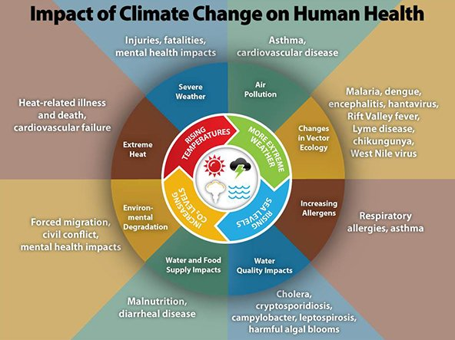
Earth Health – Preparing Student Health Professionals for Climate Change Ereca Nguyen¹, Katherine Gruenberg, PharmD, BCPS² ¹Carbon Neutrality Initiative Fellow, PharmD Candidate, ^{1,2}University of California, San Francisco School of Pharmacy
Introduction
Course Objectives
Conclusions
Climate change affects health in numerous ways. For example, extreme weather events, rising temperatures, droughts, and wildfires can disrupt our food, air, water, and shelter leading to displacement, morbidity, and mortality.
Understanding the connection between climate and health is essential for all health professionals.
For the past three years, CNI fellows from the UCSF School of Pharmacy coordinated an interprofessional elective on the topic of climate change and health, called Earth Health. A prior survey of participants in the course revealed a significant increase in students’ foundational knowledge, attitudes, and behaviors related to climate change and health following the first two years of the Earth Health elective. These results highlighted the benefit of sustainable health care education.
This year, the elective included practical actions to advance climate solutions. It is critical for learners to not only be conscious and educated about climate change, but also to be change-agents.
Describe how climate change directly and indirectly affects human health.
Outline the relationship between health care waste, health systems, and the environment.
Describe practical steps to reduce greenhouse gases in our health care system.
Describe the critical role of health professionals in climate change prevention and preparedness.
Discuss precautions and preventative measures patients can take to mitigate climate-related health risks
Identify opportunities for sustainability advocacy at the local and state policy levels.
This elective course introduced health professions students to concepts of climate change, healthcare, and the University of California Carbon Neutrality Initiative to become carbon neutral by 2025. After taking this course, participants reported a desire to continue educating themselves and others on this topic. All participants also reported plans to adjust their lifestyle choices and implement sustainable practices in their future careers.
Voices from health professions communities can help motivate social change. Advocacy can take many forms from political efforts to educating colleagues and patients about sustainable behaviors, global environmental changes, and ways to reduce carbon emission on a person and institutional level.
Project Goals
Results
This elective aimed to introduce health professional students to specific climate-related threats to the populations and patients with whom they work, provide advocacy-based information, and motivate students to lead by example through reducing the carbon emissions in their daily lives, hospitals, and clinics.
A total of eight students from the School of Pharmacy and the School of Nursing completed the survey.
Prior to the start of the course, participants:
Reported this was their first time taking a course on this topic
Agreed that climate change is relevant to direct patient care
Acknowledged the following barriers currently preventing them from addressing climate change-related health issues:
Patients may not be interested in climate change
Own lack of knowledge about how to approach the issue with patients
Agreed that learning about the impact of climate change on human health will improve their abilities as a healthcare provider
Materials and Methods
Figure 1: Dr. Williams talking about different ways to address climate anxiety and the importance of connecting with people and the environment
Earth Health: Sustainability in Health Care is a 9-week interprofessional elective course at UCSF. Students met once weekly for one-hour sessions to learn from 9 guest speakers committed to climate solutions.
Students completed a pre-course and post-course survey designed to measure participants’ knowledge, attitudes, and intended involvement in climate-related health initiatives. The surveys were also used to assess self-reported attitudes towards health professional role in climate change, identify barriers that prevented health professionals from addressing climate-related health issues, and to determine the value of climate education in promoting greater participation and involvement at UCSF.
Week | Guest Speaker | Lecture Topic
1 | Linda Rudolph, MD Director of the Center for Climate Change and Health at the Public Health Institute | Climate Change and Health
2 | Gail Lee, REHS, MS, HEM Sustainability Director at UCSF | Sustainability at UCSF CNI Fellowship
3 | Mary L. Williams, MD Dermatology Emeriti Physicians for Social Responsibility | Climate Change Agenda
4 | Robert Gould, MD President of the San Francisco-Bay Area Chapter of Physicians for Social Responsibility | Generations at Risk: Introduction to Environmental Health and Health Professional Activism
5 | Homer A. Boushey, MD Professor of Medicine, Division of Pulmonary/Critical Care Medicine | Respiratory Health Issues Citizens Climate Lobby
6 | Ted Schettler, MD Science Director of the Science and Environmental Health Network | Earth Friendly Nutrition
7 | Michael J. Martin, MD, MPH, MBA Associate Clinical Professor Department of Epidemiology and Biostatistics | Meat Consumption, Health, and the Environment
8 | Katherine Gruenberg, PharmD, BCPS Clinical Pharmacist, UCSF | Pharmaceutical Waste Management
9 | Annemarie Donjacour, PhD Activist and Professor of Anatomy at UCSF | Climate Action & Activism
Figure 2: Dr. Boushey discussing climate impacts on energy consumption and the challenges low-income communities face to access energy resources.
Future Goals
In an effort to promote greater interprofessional enrollment, a UCSF interprofessional student organization called Human Health and Climate Change will coordinate this elective next year
Following of the course, participants:
Reported the most valuable parts of the course were the speakers and learning about sustainable food, green healthcare, and advocacy efforts.
Provided specific examples of the impact of climate change on their patients’ health, such as medication waste and air pollution.
Reported considering changes to personal lifestyle choices, continuing education of self and others, and advocacy efforts after taking this course
Acknowledgements
This project was supported by University of California Office of the President, UCSF Office of Sustainability, Gail Lee, Dr. Katherine Gruenberg, and volunteer guest lecturers
Literature Cited
Kreslake JM, Sarfaty M, Roser-Renouf C, Leiserowitz AA, Maibach EW. The Critical Roles of Health Professionals in Climate Change Prevention and Preparedness. Am J Public Health. 2018;108(S2):S68–S69. doi:10.2105/AJPH.2017.304044
Peters, JL. Mitigating the Impact of Climate Change on Human Health: The Role of the Medical Community. AMA J Ethics. 2017;19(12):1153-1156. doi: 10.1001/journalofethics.2017.19.12.fred1-1712.
Teherani A, Nishimura H, Apatira L, Newman T, Ryan S. Identification of core objectives for teaching sustainable healthcare education. Med Educ Online. 2017;22(1):1386042.doi:10.1080/10872981.2017.1386042
Source: Centers for Disease Control and Prevention

